Slide 1
#OS Effectiveness of Instagram as a search tool; a visual analysis
Jackie Chu and Annie Preston
ECS 251 – OS Systems
Notes:
Both.

Slide 2
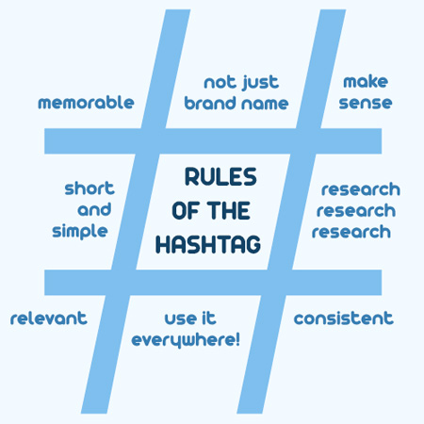
Overview
Approach
Visualization
Tag graphs
Images
Conclusion
Notes:
Annie
Talk about motivations
Why we use hashtags, versus @, location check-in
Why using this domain versus Twitter—pictures worth a thousand words? Now a thousands hashtags! (no limit on word count)
Social trends, different platform in general
Outline

Slide 3
Approach
Data retrieval
Tag search using Instagram API
Record tag metadata and its propagation
Process tag relationships into “tag graphs”
Visual analysis
Network visualization
“Characteristic” images
Notes:
Jackie
Utilize Instagram API and polled PUBLIC data. API did not allow us for private users (as it should)
Treat tags as entities and visualize their relationships
See how people contribute to tags and associated one another in a unifying post
Poll manually throughout the day
Use public tool to visualize networks
Grab images and average them

Slide 4
Instagram API
Popular versus recent
Both are not clearly defined in Instagram API documentation
Assumptions:
Popular = most likes
Recent = top x instagrams
Recent yields more results than popular
Notes:
Jackie
Media of photos and video

Slide 5
Instagram API
OAuth2.0
Notes:
Annie
OAuth2.0

Slide 6
Tags Used
Tested different domains:
Academic
Politics
Hobbies
Events
Commercial
Geographical
Tested up to 2 degrees, either popular or recent
Treating tags as representatives of the individuals/communities that used them
Notes:
Annie
Retrieval of tags limited to API requests

Slide 7
Tag Graphs
Networks visualized with Tulip
Static graph of dynamic (temporal) data
Layout algorithm:
Degree 1: Bubble Tree (Tulip)
Degree 2: Balloon (from Open Graph Drawing Framework)
Visual indicators
Color
Magnitude of its media count
Network structure
Internal connections between clusters
Tag category
Adjective (e.g., descriptor, emotions)
Nouns (e.g., events, places, objects)
Phrases (e.g., opinions, humor, trending)
Private vs. public contributions (inferred by media count)
Notes:
Jackie
Balloon matches with our original layout design we wanted to implement. Radial graph lays out the information clearly and seems to scale well.

Slide 8
Tag Graphs: academics
#ucdavis (recent media, degree 2)
Notes:
Jackie
Impressions, student related

Slide 9
Tag Graphs: politics
#election (recent media, degree 2)
Notes:
Annie
Impressions

Slide 10
Tag Graphs: hobbies
#food (popular media, degree 2)
Notes:
Jackie
Impressions

Slide 11
Tag Graphs: events
#commencement (recent media, degree 1 )
Notes:
Jackie
Impressions

Slide 12
Tag Graphs: commercial
#shareacoke (popular media, degree 2)
Notes:
Annie
Impressions

Slide 13
Tag Graphs: geographical
#socal (recent media, degree 2)
Notes:
Annie
Impressions

Slide 14
Tag Graphs: #nbaplayoffs
Temporal changes
6/7/2015
6/8/2015
Notes:
Jackie
Temporal example

Slide 15
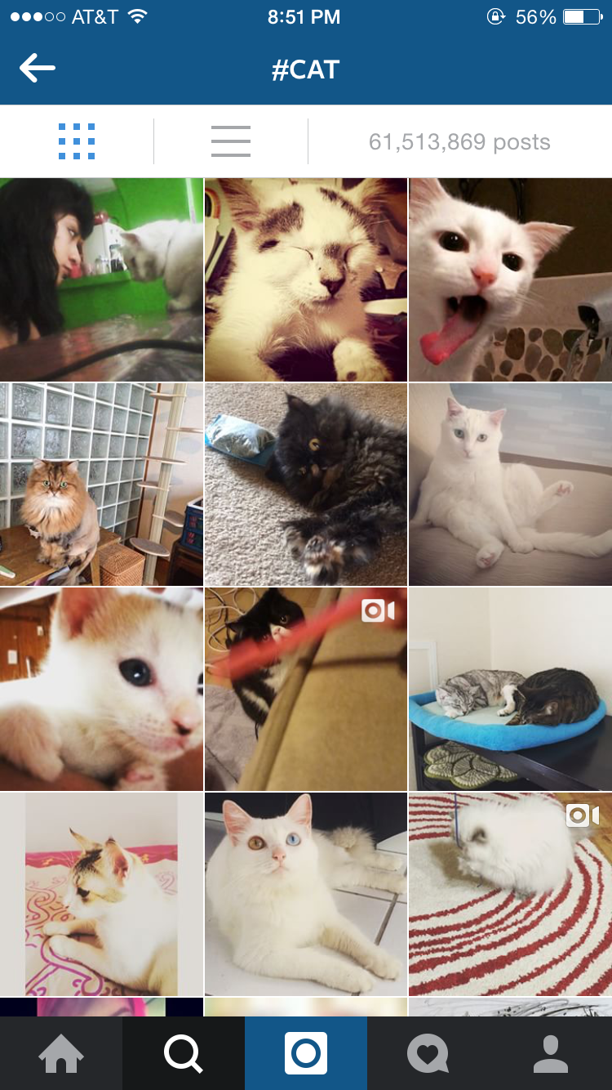

Characteristic images
Average top 20 recent photos related to tag
Determine if resulting image reinforces effectiveness of tags
Notes:
Annie

Slide 16
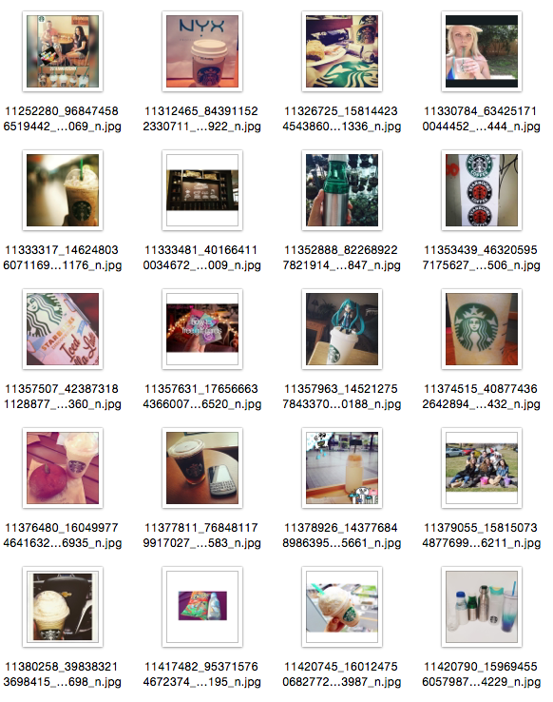

Characteristic images: #starbucks
Notes:
Jackie

Slide 17

Characteristic images: #ucdavis
Notes:
Jackie
Example of spam used for these advertisements
Validity/integrity of content

Slide 18
Conclusions
A good tool for seeing how tags are used and its affiliation with other tags
May not be best tool for searching content, but more for opinions
Need to consider Instagram audience
Application used internationally
Restricted to those with smartphones and documents with photos/videos
Requires filtering techniques, e.g. linguistic-based, since anything can be made a hashtag
Notes:
Annie
Can be a useful tool for varying levels: individual, communities, companies, international, how tags are used/affiliations with other tags
Awareness of spam/popular → devaluing the search, suggests bots boosting certain posts
Cultural/geographical (e.g. graduation) differences

